Slide 1
Mixed-Language Programming
Smart Platforms Lab (TRC)
Anthony Berkow
February 2025

Slide 2
What is mixed-language programing?
Usually one chooses some specific high-level language to develop an application in:
C or C++ or Fortran or Python, etc.
Choose the language that best suits the programming task.
However it is possible to mix any number of languages in a single binary library or executable:
C++ code using standard Linux libraries written in C.
This is very common!
Python code using standard Linux libraries written in C.
Possible using the Python ctypes module but not very convenient.
Writing a Fortran module in C++ for use by Fortran.
Writing a Python module in C++ for use by Python.
Many Python modules are written in C or C++ (e.g. numpy).
Using any Python module from C++.
Python is embedded in C++ to run the code in the same process and even on the same thread.
Note: We are not interested in forking a new process to run a Python script.
The Python community do not encourage this as they do not want Python to be subservient to C++.
- The reasons are political not technical.

Slide 3
Requirements
Development server – you can use WSL to run Ubuntu on your laptop.
gcc, CMake, Python:
sudo apt update
sudo apt install build-essential cmake python3.12-dev
git clone https://github.com/TRC-HPC/mixedlang.git

Slide 4
ex1: Writing a simple function in a low-level language (x86_64 assembly)
Compilers such as C and C++ generate assembly language before converting to object code.
Therefore let us start with the most basic example of assembly language, just to illustrate code compilation.
Create a trivial function to add two integers. In C the signature would be:
int add(int, int);
On x86_64 the System V ABI (Application Binary Interface) specifies the naming and calling conventions for compilers.
For the INTEGER class (int, long, etc.):
Note: 32-bit register eax is the lower half of rax. The same for other registers.
A 2nd return value can be passed in rdx for a total of 128 bits.
arch | width | return value | arg 0 | arg 1 | arg 2 | arg 3 | arg 4 | arg 5 | …
x86_64 | 64-bit | rax [rdx::] | rdi | rsi | rdx | rcx | r8 | r9 | on stack
 | 32-bit | eax [edx::] | edi | esi | edx | ecx | e8 | e9 | on stack
aarch64 | 64-bit | x0 | x0 | x1 | x2 | x3 | x4 | x5 | x*
 | 32-bit | w0 | w0 | w1 | w2 | w3 | w4 | w5 | w*

Slide 5
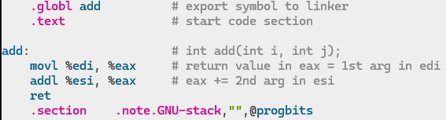
ex1: Writing a simple function in a low-level language (x86_64 assembly)
Assuming you already cloned the mixedlang repo:
cd mixedlang
git checkout ex1
cd ex1
vim add.s
(Note: You can omit the .note.GNU-stack section but will get a linker warning.)
On aarch64:
add w0, w0, w1 # w0 = w0 + w1
ret
Run assembler to generate object file add.o (for convenience just use gcc to call the assembler):
gcc -c add.s -o add.o
Note: gcc is just a wrapper program that calls the C pre-processor/compiler, assembler, linker, etc.
It automatically links to libc.so (g++ links to libstdc++.so).
View symbols in add.o (we can think of this as a simple library):
nm add.o

Slide 6
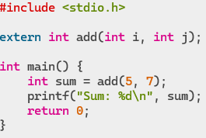
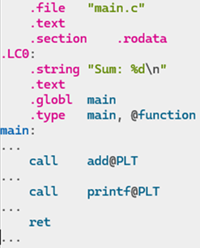
ex1: Writing a simple program in a high-level language (C)
Write a simple C program to call the assembled add() function:
vim main.c
To illustrate what happens in gcc use the -S option to run the C pre-processor to compile main.c, but stop immediately after assembly language gen (do not convert to object code) :
gcc -S -c main.c -o main.s
vim main.s

Slide 7
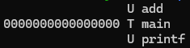
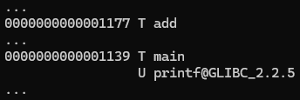
ex1: Writing a simple program in a high-level language (C)
Compile main.s into object code in main.o:
gcc -c main.s -o main.o
View symbols in main.o:
nm main.o
Link main.o and add.o into executable named demo1:
gcc main.o add.o -o demo1
View symbols in demo1:
nm demo1
Run the program:
./demo1

Slide 8
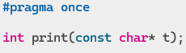
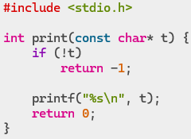
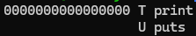
ex2: Writing a simple function in C
Write a simple C function to output some text:
git checkout ex2
cd ../ex2
vim textc.h
vim text.c
Compile the C function into object code:
gcc -c text.c -o textc.o
View symbols in textc.o (we could add this to a library):
nm textc.o

Slide 9
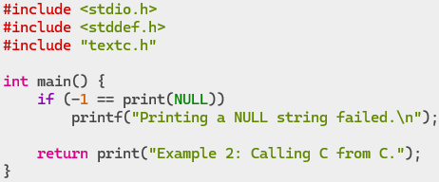
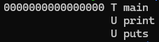
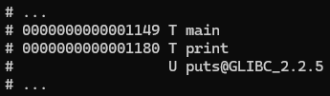
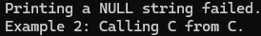
ex2: Write a simple C program to use a C library
Write a simple C program to call the C print() function:
vim main.c
Compile the C program into object code:
gcc -c main.c -o mainc.o
View symbols in mainc.o:
nm mainc.o
Link mainc.o and textc.o into executable named demo2:
gcc mainc.o textc.o -o demo2
View symbols in demo2:
nm demo2
Run the program:
./demo2

Slide 10
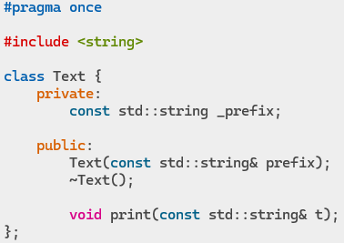
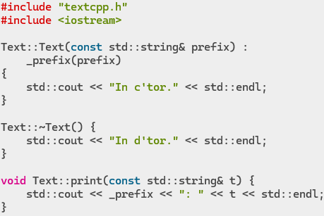
ex2b: Write a simple class in C++
Write a simple C++ class with a function to output some text:
git checkout ex2b
vim textcpp.h vim text.cpp

Slide 11
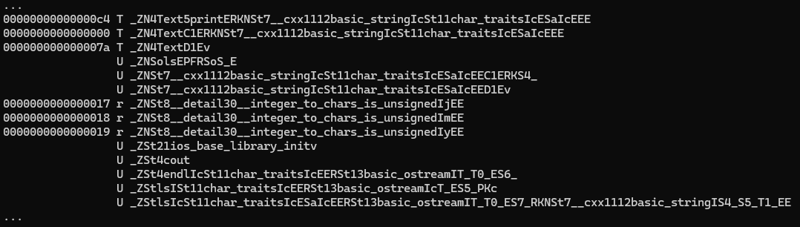
ex2b: Write a simple class in C++
Compile the C++ class into object code (could be added to a library):
g++ -c text.cpp -o textcpp.o
View symbols in textcpp.o:
nm textcpp.o

Slide 12
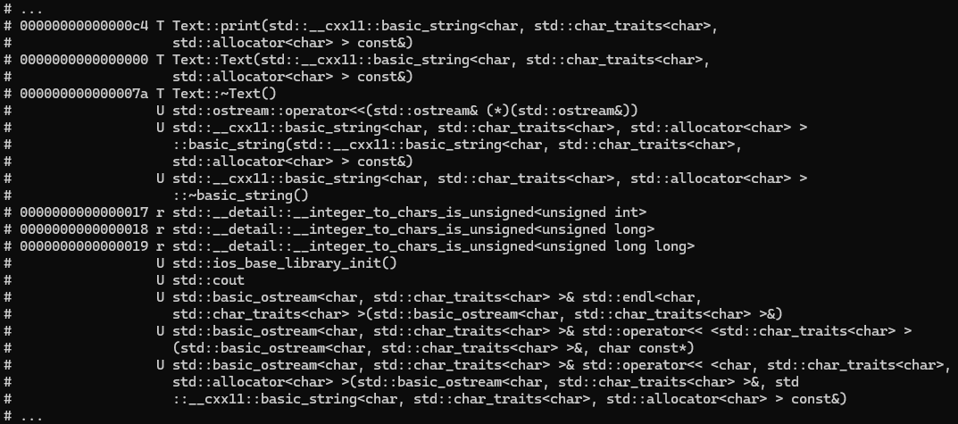
ex2b: Write a simple class in C++
View symbols in textcpp.o and unmangle names with -C option:
nm -C textcpp.o

Slide 13
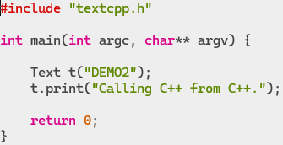
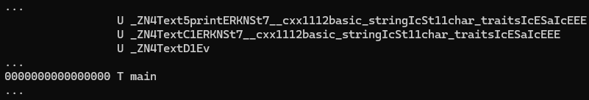
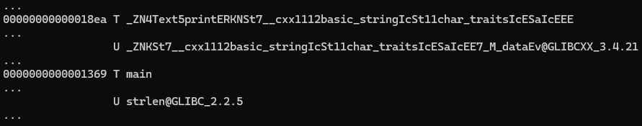
ex2b: Write a C++ program to use a C++ library
Write a simple C++ program that uses the C++ library:
vim main.cpp
Compile the C++ program into object code:
g++ -c main.cpp -o maincpp.o
View symbols in maincpp.o:
nm maincpp.o
Link maincpp.o and textcpp.o into executable named demo2cpp:
g++ maincpp.o textcpp.o -o demo2cpp
View symbols in demo2cpp:
nm demo2cpp

Slide 14
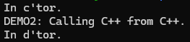
ex2b: Write a C++ program to use a C++ library
Run the program:
./demo2cpp

Slide 15
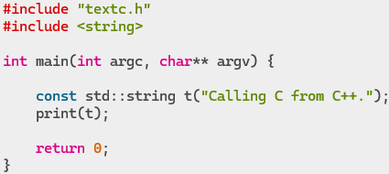
ex2c: Write a C++ program to use a C library
This is very common – C++ often uses Linux OS libraries written in C.
Calling C from C++ is trivial since C++ is built on top of C.
Write a C++ program that uses the C library:
git checkout ex2c
vim maincpp_c.cpp
Compile the C++ program into object code:
g++ -c maincpp_c.cpp -o maincpp_c.o
Will this compile?

Slide 16
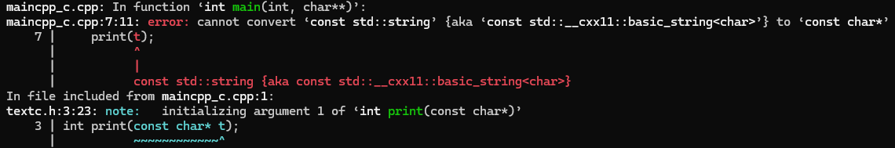
ex2c: Write a C++ program to use a C library
Compilation fails!
print() expects a char* and does not know about std::string.

Slide 17
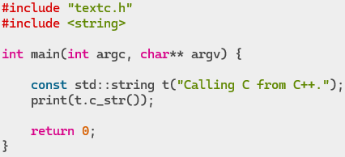
ex2c: Write a C++ program to use a C library
Use std::string::c_str() to return a const char* to the string.
git checkout ex2c2
vim maincpp_c.cpp
Recompile the C++ program:
g++ -c maincpp_c.cpp -o maincpp_c.o
Then link maincpp_c.o and textc.o into executable named demo2cpp_c:
g++ maincpp_c.o textc.o -o demo2cpp_c
Will this link?

Slide 18
ex2c: Write a C++ program to use a C library
Linking fails!
The linker cannot find print even though we linked to textc.o.

Slide 19
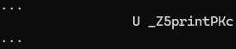
ex2c: Write a C++ program to use a C library
View symbols in maincpp_c.o:
nm maincpp_c.o
The print function signature is mangled since this is C++ and no such function exists in textc.o!

Slide 20
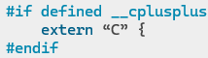
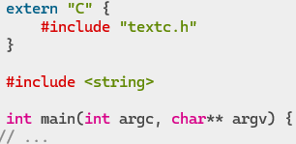
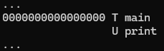
ex2c: Write a C++ program to use a C library
Use extern “C”{…} to tell C++ compiler that the enclosed block uses the C ABI!
No name mangling will occur in an extern “C” block.
Note: Most standard Linux C headers already include something equivalent to:
git checkout ex2c3
vim maincpp_c.cpp
Recompile the C++ program:
g++ -c maincpp_c.cpp -o maincpp_c.o
View updated symbols in maincpp_c.o:
nm maincpp_c.o
Link the program:
g++ maincpp_c.o textc.o -o demo2cpp_c
Run the program:
./demo2cpp_c

Slide 21
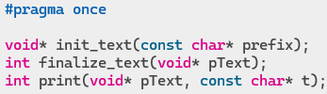
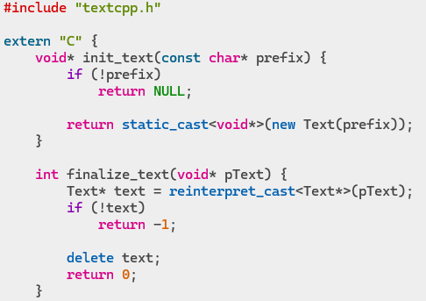
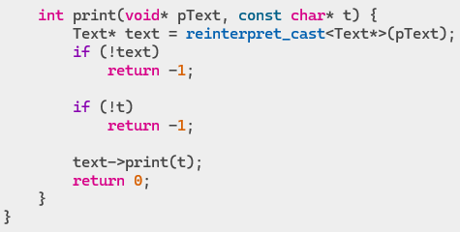
ex2d: Write a C program to use a C++ library
Calling C++ from C is a little more involved since C does not know about C++.
Therefore we need to write a C wrapper for the C++ code:
git checkout ex2d
vim textcpp_c.h
vim textcpp_c.cpp Note: The C wrapper is written in C++.

Slide 22
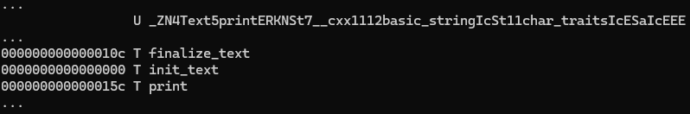
ex2d: Write a C program to use a C++ library
Compile the C wrapper:
g++ -c textcpp_c.cpp -o textcpp_c.o
View the symbols in textcpp_c.o:
nm textcpp_c.o
Note: You would usually link the C wrapper (textcpp_c.o) and the C++ code (textcpp.o) into a single shared library (such as libtextcpp.so), but we will not bother with this here.

Slide 23
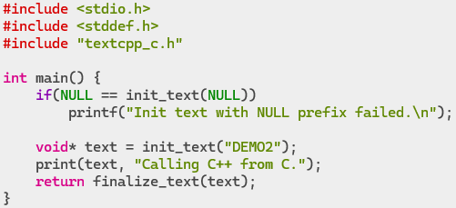
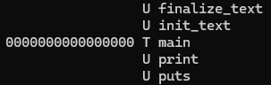
ex2d: Write a C program to use a C++ library
Write a C program that uses the C++ library:
vim mainc_cpp.c
Compile the C program into object code:
gcc -c mainc_cpp.c -o mainc_cpp.o
View the symbols in mainc_cpp.o:
nm mainc_cpp.o

Slide 24
ex2d: Write a C program to use a C++ library
Link mainc_cpp.o, textcpp_c.o and textcpp.o into executable named demo2c_cpp:
gcc mainc_cpp.o textcpp_c.o textcpp.o -o demo2c_cpp
Will this link?

Slide 25
ex2d: Write a C program to use a C++ library
Linking fails!
Linker cannot find any of the standard C++ symbols.

Slide 26
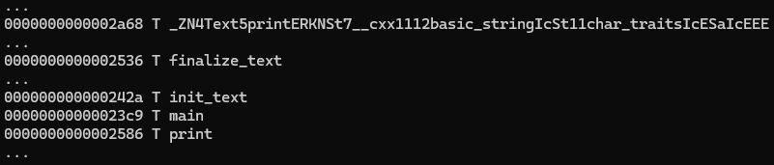
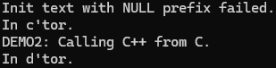
ex2d: Write a C program to use a C++ library
We need to also link to libstdc++.so:
gcc mainc_cpp.o textcpp_c.o textcpp.o -o demo2c_cpp -lstdc++
View symbols in demo2c_cpp:
nm demo2c_cpp
Run the program:
./demo2c_cpp

Slide 27
ex2d: Write a C program to use a C++ library
How else could the C wrapper handle the class instance?

Slide 28
ex2d: Write a C program to use a C++ library
This could be a logger class and we want a singleton instance.
So we do not need to pass around a pointer.

Slide 29
ex2d: Write a C program to use a C++ library
The void* could contain garbage resulting in a crash.
How can we avoid passing around void pointers?

Slide 30
ex2d: Write a C program to use a C++ library
We could hold a map of Text pointers and return an int handle to the entry.
Either the handle is in the map or it is not.
This is much safer.
No need for reinterpret casts.
On termination we could have a handler to delete any instances still in the map.
What if the program is multithreaded?

Slide 31
ex2d: Write a C program to use a C++ library
If the program is multithreaded we would need a mutex to protect the map.
What if a C++ method throws an exception?

Slide 32
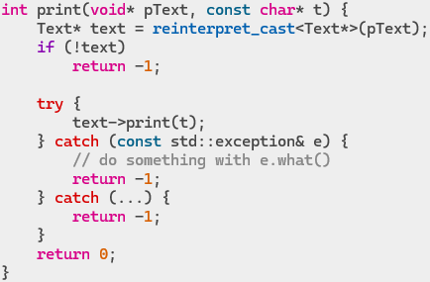
ex2d: Write a C program to use a C++ library
We must catch all exceptions and return an error to C:

Slide 33
ex3: Making a C++ library usable from other languages
Once a complex C++ library has been written, users might want to use it from other languages:
C, Fortran, Python, etc.
e.g. ADIOS and MPI provide wrappers for several languages.
You do not want to rewrite the entire library to support another language.
Just provide suitable wrapper functions and/or language-specific modules (that are themselves just wrappers).
For compiled languages these modules are usually linked into the same shared library as the C++ code.
For an interpreted language like Python a separate shared library is needed (linked to the C++ library).
The Python module is a shared library with a different naming convention to standard libraries.
If you link your main C++ library to Python, all users become dependent on Python even if they do not use Python.
Your C++ library might include a custom logger used by the library itself.
You would want the users of the library to use the same C++ logger to avoid having multiple log files.
It is much simpler to build such libraries using a build system such as CMake.

Slide 34
ex3a: Building a C++ library using CMake
Create a suitable directory structure for the project under the directory ex3:
include – public header files required by users of the library.
src – source code for the libraries.
apps – demo programs that use the libraries.
build – build directory for all code.
modules – Python modules (written in Python script).

Slide 35
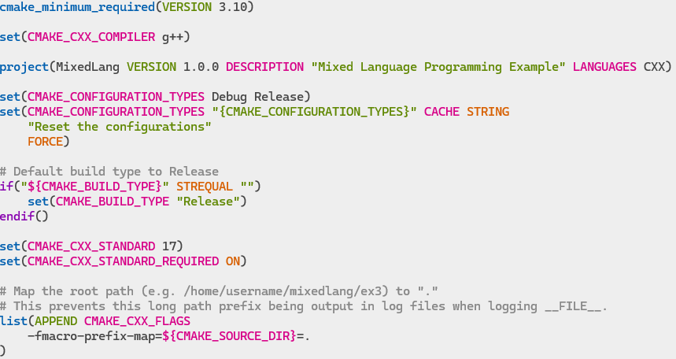
ex3a: Building a C++ library using CMake
Create the top-level (root) CMakeLists.txt file used to define the CMake project:
git checkout ex3
cd ../ex3
vim CMakeLists.txt

Slide 36
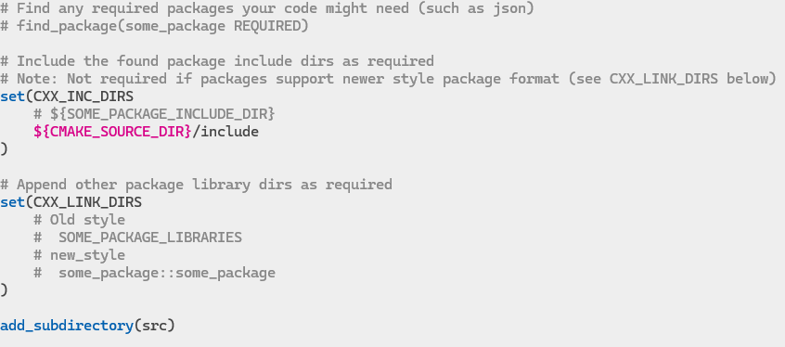
ex3a: Building a C++ library using CMake

Slide 37
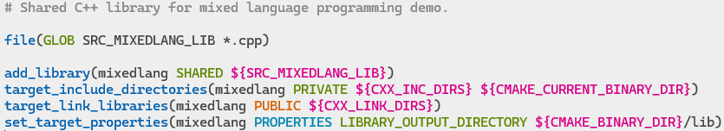
ex3a: Building a C++ library using CMake
Create a directory under src/ for the C++ library:
mkdir src/mixedlang_lib
Create the src/CMakeLists.txt file:
Create the src/mixedlang_lib/CMakeLists.txt file:

Slide 38
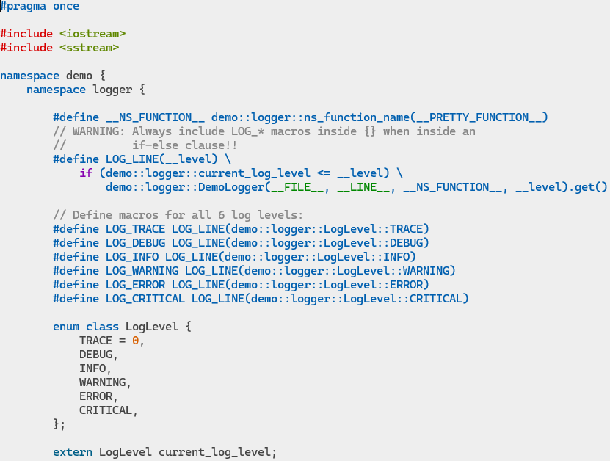
ex3a: Building a C++ library using CMake
Add a simple logger class to the C++ library.
Create the public header file include/logger.h

Slide 39
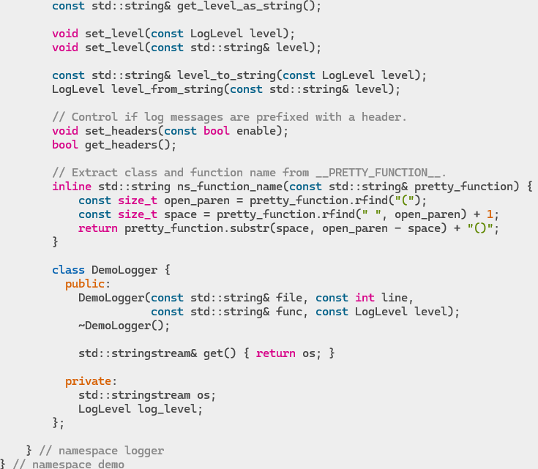
ex3a: Building a C++ library using CMake

Slide 40
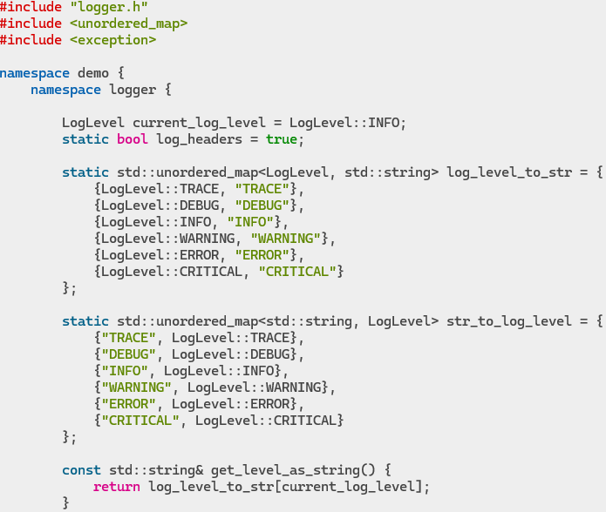
ex3a: Building a C++ library using CMake
Create the implementation of the logger in src/mixedlang_lib/logger.cpp

Slide 41
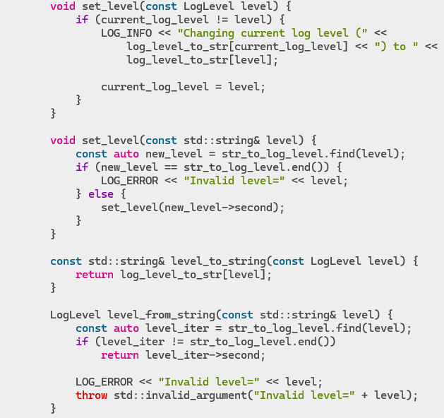
ex3a: Building a C++ library using CMake

Slide 42
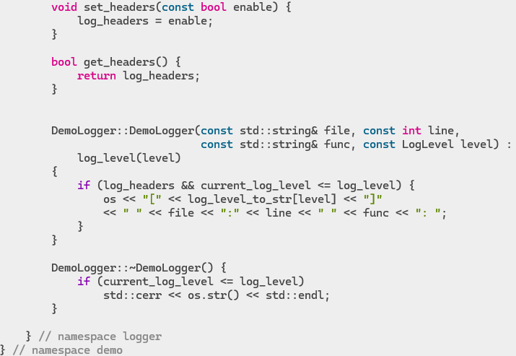
ex3a: Building a C++ library using CMake

Slide 43
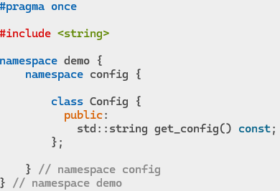
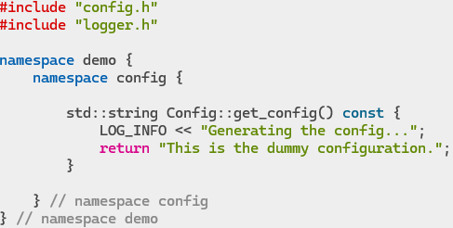
ex3a: Building a C++ library using CMake
Add a simple config class to the C++ library.
This will be a dummy class just for demo purposes.
It will itself use the logger.
Create the header file include/config.h and the implementation src/mixedlang_lib/config.cpp

Slide 44
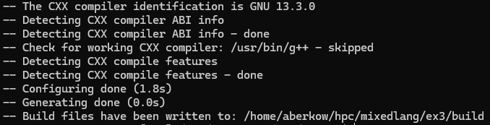
ex3a: Building a C++ library using CMake
Create the build directory structure and makefiles using CMake:
cd build
cmake ..
The build directory will now contain:
CMakeCache.txt – cache used by CMake.
CMakeFiles/ – files used internally by CMake.
Makefile – the top-level make file generated for use by make.
cmake_install.cmake – a CMake install script for the project.
lib/ – the compiled libraries (currently empty).
src/ – the make, object and dependency files, etc. corresponding to the upper src directory.

Slide 45
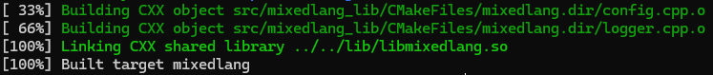
ex3a: Building a C++ library using CMake
Build the project:
make
The lib directory now contains the built library:

Slide 46
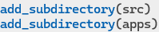
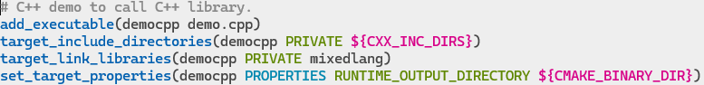

ex3b: Building a C++ program using CMake
Create a C++ demo app to use the C++ logger and config library.
Update the top-level CMakeLists.txt file to include the apps directory:
git checkout ex3b
vim CMakeLists.txt
Create the apps/CMakeLists.txt file:
Create the app apps/demo.cpp

Slide 47

ex3b: Building a C++ program using CMake
Update Cmake files and build the project:
cd build
cmake ..
make
The build directory will now also contain:
apps/ – the make, object and dependency files, etc. corresponding to the upper apps directory.
Other executable binaries:
Run the program:
./democpp

Slide 48

ex3c: Making a C++ library usable from C
We have already seen how to call C++ code from C.
Add C wrapper functions (written in C++) (linked into the same shared library).
Provide a C wrapper header file.
Optionally use #ifdef logic to automatically detect the language and include the correct headers.
e.g. text.h

Slide 49



ex3c: Adding a C wrapper to a C++ library
Update the top-level CMakeLists.txt file to support C in addition to C++:
git checkout ex3c
vim CMakeLists.txt
Append C to LANGUAGES:
Insert the required version of C:
Append -fmacro-prefix-map to CMAKE_C_FLAGS (copied from CMAKE_CXX_FLAGS):
Insert C_INC_DIRS:

Slide 50

ex3c: Building a C program using CMake
Create a C demo app to use the C++ logger and config library.
Update the apps/CMakeLists.txt file to add the new C app:

Slide 51

ex3c: Building a C program using CMake
Create the app apps/demo.c
Note: At this point the two C wrapper header files do not yet exist.
Create the logger and config C wrapper header files include/logger_c.h and include/config_c.h
What changes do we need to convert logger.h and config.h to logger_c.h and config_c.h ?

Slide 52
ex3c: Adding a C wrapper to a C++ library
In C we use __FUNCTION__ instead of __PRETTY_FUNCTION__ as C has simple function signatures.
We do not require code to abbreviate long C++ function names.
C cannot use the C++ enum class LogLevel.
Create a simple enum LogLevel for C.
We do not really need separate macros for each log level.
LOG_LINE(demo::logger::LogLevel::INFO) becomes simply LOG(INFO).
C does not support a stream operator<< so we need printf() semantics.
#define LOG(__level, __format, ...)
void log_msg(const int level, const char* file, const int line, const char* func, const char* format, ...);
Why use the name log_msg() and not just log() ?
In C we already have log() in the math library and C does not support overloaded functions.
How do we pass the … in the C macro to the function call to log_msg() ?
… is passed using __VA_ARGS__
But we cannot insert a comma if there are no additional args so we use __VA__OPT__(,)

Slide 53

ex3c: Adding a C wrapper to a C++ library
Create the C wrapper header file include/logger_c.h
git checkout ex3c2
vim include/logger_c.h

Slide 54

ex3c: Adding a C wrapper to a C++ library
Create the C wrapper header file include/config_c.h
Create the implementation of the C wrappers:
src/mixedlang_lib/logger_c.cpp
src/mixedlang_lib/config_c.cpp
How will you convert between int and enum class LogLevel ?
How will you handle exceptions?
How do you handle variadic arguments?

Slide 55

ex3c: Adding a C wrapper to a C++ library
Create the implementation of C wrapper src/mixedlang_lib/logger_c.cpp
git checkout ex3c3

Slide 56

ex3c: Adding a C wrapper to a C++ library

Slide 57

ex3c: Adding a C wrapper to a C++ library
Create the implementation of the C wrapper src/mixedlang_lib/config_c.cpp

Slide 58

ex3c: Building a C program using CMake
Build and run the app:
cd build
cmake ..
make
./democ

Slide 59
ex3d: Making a C++ library usable from Fortran
Fortran is also a compiled language.
So the process is similar to C except we create an actual Fortran module.
Add Fortran C wrapper functions (written in C++) (linked into the same shared library).
The cpp file also requires an extern “C” block to prevent C++ name mangling.
The exported function names have special requirements for Fortran (such as all uppercase).
A special macro (FC_GLOBAL) is used to declare all function names correctly.
This macro is in the header file FC.h (generated by CMake).
For Fortran subroutines all functions are declared void (return values are passed as arguments).
Additionally add a Fortran module (written in Fortran) that calls the Fortran C wrapper functions.
The Fortran module itself is just a lightweight wrapper.
It performs some special handling for the fixed-length strings used by Fortran.
It can perform memory allocation to handle variable-length strings.
Fortran does not use a header file for the wrappers and module.

Slide 60

ex3d: Writing a Fortran module using a C++ library
Update the top-level CMakeLists.txt file to support Fortran in addition to C++ and C:
git checkout ex3d
vim CMakeLists.txt
Enable the language Fortran and tell the Fortran compiler where to find Fortran modules:
Update the C++ library src/mixedlang_lib/CMakeLists.txt to:
Include the Fortran C interface.
Generate a macro header file to help declare Fortran style function names.
Also compile Fortran source code (*.f90) in addition to *.cpp.

Slide 61

ex3d: Writing a Fortran module using a C++ library
Create a convenience header file to define a simple LOGGER macro in include/logger_f.h
Note:
No header file is required for Fortran, but this macro is useful.
Fortran does not support -fmacro-prefix-map for __FILE__.
Fortran does not support __FUNCTION__.

Slide 62

ex3d: Writing a Fortran module using a C++ library
Create the Fortran bindings (Fortran C wrapper) for our C++ library.
vim src/mixedlang_lib/fc_mixedlang.cpp

Slide 63


ex3d: Writing a Fortran module using a C++ library

Slide 64


ex3d: Writing a Fortran module using a C++ library

Slide 65


ex3d: Writing a Fortran module using a C++ library
Create the actual Fortran module for our C++ library.
vim src/mixedlang_lib/mixedlang_mod.f90

Slide 66

ex3d: Writing a Fortran program using a C++ library
Create a Fortran demo app to use the C++ logger and config library via the Fortran module.
Update the apps/CMakeLists.txt file to add the new Fortran app:

Slide 67

ex3d: Writing a Fortran program using a C++ library
Create the app apps/demo.F90

Slide 68

ex3d: Writing a Fortran module using a C++ library
Now build our project:
cd build
cmake ..
make
The lib directory now contains the built Fortran module as well as the C++ library:
Run the program:
./demof

Slide 69

ex4: Making a C++ library usable from Python
Unlike the other languages Python is an interpretive language.
The interpreter front end interprets a Python script and converts it to byte code at runtime.
The byte code for some_module.py is cached in the file some_module.pyc.
At the core of the interpreter is the PVM (Python Virtual Machine) that executes the byte code by calling functions in the Python runtime library.
For example, running python3 from the CLI, compiling some byte code, and disassembling it:

Slide 70
ex4: Making a C++ library usable from Python
However Python modules can also be written in a compiled language like C or C++.
We use the Python C API to write Python code in C or C++.
A python module could be:
a file some_module.py
a directory named some_module
A zip file named some_module.zip
A shared library named some_module.so
Adding a Python module (written in C++) that makes use of the C++ library code:
The Python module is a wrapper for the C++ code but the functions are a lot more complex.
The module is linked into a separate shared library (that itself links to the main C++ library).
The module library does not use the standard library naming convention of lib<lib_name>.so.
There is no lib prefix – the library is simply named <module>.so.

Slide 71

ex4: Python C API and PyObject
The Python runtime is exposed through the Python C API (CPython).
All objects in Python derive from the base type of PyObject.
Note: This is a C API and not C++ but you can think of Python objects as being classes.
The members of a Python object reside at the start of allocated memory just as in C++.
A PyObject holds just the object reference count and a pointer to the corresponding type object.
Every pointer to a Python object can be cast to a PyObject*.
This means that even a basic type such as a Boolean or Integer is a PyObject and has a reference count.
For example a basic Python array of a million integers would hold a million reference counts.
Python is very inefficient compared to C++ and working efficiently with arrays requires using an external library such as NumPy, where a NumPy array is a PyObject but the contents are a regular raw C-type array.

Slide 72
ex4: PyObject and immortal objects
A PyObject is therefore similar to a C++ std::shared_ptr except:
In Python script the interpreter automatically handles reference counting.
However when using the C API:
The reference count is not automatically incremented when calling a function.
The reference count is not automatically decremented when the object goes out of scope.
The user must manually call Py_IncRef() or Py_DecRef() when required.
The allocated memory of all Python objects contains some mutable state, such that even immutable objects are actually mutable.
As an optimization some immutable objects such as True and False, None and Integers from -5 to 255 are given a special (immortal) reference count that never changes even when Py_IncRef() and Py_DecRef() are called.
Immortal objects are therefore never deallocated while the interpreter is running and can never be altered.
The use of immortal objects is transparent to the user.

Slide 73
ex4: PyObject reference counting and strong references
Reference counting is the trickiest part of using the Python C API.
When you call a function to return a new PyObject instance, the reference count will usually be 1.
When a function returns an existing object instance, the reference count could be >1.
If code (including your own) returns an object it should not decrement the reference count since the caller will become the new owner of that reference.
Therefore when a function returns an object to your code, you usually now own a reference to the object.
When any code owns a reference this is referred to as a strong reference.
It is the responsibility of any code holding a strong reference to decrement the reference count (Py_DecRef()) once they are done with the object (except if returning it), so that it can be deleted (if the reference count has reached 0).
Note: Some operations are implemented both as a function (such as Py_DecRef()) and as a macro (such as Py_DECREF()).
The behavior of each is not identical: Py_DecRef() can accept a NULL pointer (like Py_XDECREF()).
It is better to use functions than macros in embedded code.
Neither have any effect on immortal objects.

Slide 74
ex4: PyObject reference counting and borrowed references
If any code (including your own) is called with an object, the reference count will not have been incremented and the code does not own a reference to the object.
When any code does not own a reference this is referred to as a borrowed reference.
An object with a borrowed reference can become a dangling pointer if the object is deleted. For example the GC (garbage collector) can remove the last strong reference to an object and delete it.
It is the responsibility of any called function to increment the reference count on a borrowed reference (converting it to a strong reference) if it needs to hold a reference to the object after returning to the caller.
The code can either call Py_IncRef(), or Py_NewRef() to create a new strong reference.
It is advisable in any case to convert a borrowed reference to a strong reference while using it in the case of multi-threaded code.

Slide 75
ex4: Borrowed references and stolen references
Warning: Some older functions such as PyList_SetItem() will not increment the reference count, so if the caller releases the object it could be deleted and now the List will hold a dangling pointer resulting in a crash.
A function that assumes it is the owner of a borrowed reference (it does not increment the reference count) is said to steal the reference.
If a function steals a reference, the caller has to either increment the reference count before calling it, or not decrement the reference count afterwards.
Similarly, some functions only return a borrowed reference instead of a strong reference, such as PyDict_GetItem().
The only way to know if a function steals a reference (or returns a borrowed reference) is to check the documentation for each function.
Warning: When an object is deleted it could execute arbitrary code (such as the Python destructor __del__()) which has access to global variables. Therefore, for example, when deleting an object from a list one should first copy a reference to a temporary variable, update the list, then decrement the temporary reference count.

Slide 76

ex4: GC (Garbage Collection)
If an object holds a reference to another object and vice-versa, then a circular reference dependency is created where the objects can never be deleted.
In Python GC (Garbage Collection) is scheduled to run periodically, such as when the number of allocations exceeds the number of deallocations by some threshold.
GC will detect cyclic references that are no longer being used and delete the objects.

Slide 77


ex4: CPython function signatures
In languages such as C and C++, functions can have any number of arguments but only one return value.
The return value could be some complex type like a struct or std::tuple however, holding many values.
Similarly, in Python script a function can have any number of arguments, but also any number of return values such as return x,y,z and the caller can do: x,y,z = foo().
In addition, Python supports named arguments such as calling foo(i=1, j=7).
When converted to CPython, all such functions typically become simply:
Both the arguments and the return value are both just Lists of PyObjects.
For named arguments:
There are other options such as:
A C-type array PyObject** args and the number of arguments in the array Py_ssize_t nargs.
A single PyObject* as an argument that is not a list of arguments but rather a specific object.
Note: If a function returns NULL then it is expected that an exception was raised and the exception is available in an Error object.

Slide 78

ex4: Python module written in C++
Update the top-level CMakeLists.txt file to support Python in addition to C++, C and Fortran:
git checkout ex4 (remain in directory ex3)
vim CMakeLists.txt
Add find_package command for Python components for module development.
Note: Possible components include (this is not the full list):
Interpreter
Development.Embed (library type SHARED, which can be a module too)
Development.Module (library type MODULE)
NumPy (requires pip install numpy)
Add a custom target to copy any Python modules (written in Python) to the build directory.
Create the empty modules directory if you want to run CMake right now:
mkdir modules

Slide 79


ex4: Python module written in C++
We will name the Python module pymixedlang since the C++ library is already named mixedlang.
Create a directory under src/ for the C++ Python module:
mkdir src/pymixedlang_mod
Add this new directory to src/CMakeLists.txt file:
Create the src/pymixedlang_mod/CMakeLists.txt file:
Note: Python_add_library automatically adds Python::Python (for type SHARED) or Python::Module (for type MODULE) to target_link_libraries, and PREFIX “” to set_target_properties.

Slide 80

ex4: Python module written in C++
Create the Python module header file src/pymixedlang_mod/module_pymixedlang.h
Note: This header file is only needed if you want to use your module in C++ code when embedding Python in C++. It is not needed to create a Python module.
The PyMODINIT_FUNC PyInit_pymixedlang() function is the single entry point into the module shared library used by Python to import the module.
Defining PY_SSIZE_T_CLEAN tells Python to use Py_ssize_t for length args rather than int.

Slide 81

ex4: Python module written in C++
Create the Python module implementation in src/pymixedlang_mod/module_pymixedlang.cpp
Include the module header file (or directly include Python.h).
Include the C++ headers we need.
Define the name of the module (char*).
Create the module documentation string using the special PyDoc_STRVAR() macro.
Declare a PyObject* to hold any error (exception) that might be raised if a method fails.

Slide 82

ex4: Python module written in C++
module_pymixedlang.cpp continued…
Implement the module methods that wrap the C++ methods.
Start with the simplest example of set_headers() and get_headers().
These functions are static so their names are not exported by the library.

Slide 83

ex4: Python module written in C++
module_pymixedlang.cpp continued…

Slide 84

ex4: Python module written in C++

Slide 85

ex4: Python module written in C++
s: str (const char*)
K: int (uint64_t)
Note: There is no such function as logger::log() – we will need to add it.

Slide 86

ex4: Python module written in C++
module_pymixedlang.cpp continued…

Slide 87

ex4: Python module written in C++
module_pymixedlang.cpp continued…

Slide 88

ex4: Python module written in C++
Add new logger::log() function to include/logger.h and src/mixedlang_lib/logger.cpp

Slide 89

ex4: Python module written in C++
Build the Python module and try it out in the Python CLI:
cd build
cmake ..
make
This builds the new module as a shared library:
Launch Python and try out the module:
python3

Slide 90


ex4: Python module written in C++
Get help on the module:
…

Slide 91
ex4: Python module written in C++
Try execute our module get_config() method:
Change our log level:

Slide 92

ex4b: Python module wrapper written in Python
In Python one usually uses the standard Python logging module.
In this case it is best to write a Python wrapper to expose our Python module logger functionality as an extension of the Python logging module by writing a custom logging.Handler class.
Create a Python module modules/mixedlang
git checkout ex4b
mkdir modules/mixedlang
Create a modules/mixedlang/__init__.py script:
Create the modules/mixedlang/logger.py script:

Slide 93

ex4b: Python module wrapper written in Python
logger.py continued…

Slide 94

ex4b: Python module wrapper written in Python
logger.py continued…

Slide 95



ex4b: Python module wrapper written in Python
Copy the new Python module to the build/modules directory and try it out in the Python CLI:
git checkout ex4b
cd build
make
This copies the modules directory:
ls -R modules/mixedlang
Launch Python and try out the module:
python3
Here the default logger was used because we forgot to add the lib folder to the path.
Try again:

Slide 96

ex4b: Python module wrapper written in Python
Try change the log level:

Slide 97

ex4c: Python program using a module written in C++
Create a demo Python script apps/py_scripts/demo.py
git checkout ex4c

Slide 98

ex4c: Python program using a module written in C++
Add a custom target to apps/CMakeLists.txt to copy any Python scripts to the build directory:
Copy the demo Python script:
cd build
cmake ..
make
Run the program:
./demo.py

Slide 99
ex5: C++ program calling Python module
When writing more complex Python code in C++, management of C PyObject* references starts to become tedious.
It is useful to write a C++ wrapper class for the PyObject* so it behaves similarly to a std::shared_ptr (such as a PyObjectPtr class).
Embedding Python inside of C++:
When using a C++ module inside Python, the Python interpreter takes care of several things we do not need to deal with. This changes when embedding the Python runtime inside of a C++ program.
Initializing and finalizing the Python runtime:
As we have seen with other C wrappers for libraries, it is usual to have to initialize the library and/or its classes before use, and to destroy (finalize) them when finished.
We need to call Py_Initialize() and Py_FinalizeEx() at some point in our code.
GIL (Global Interpreter Lock):
Allows only one thread to hold control of the Python interpreter at a given time.
We need to acquire the GIL before calling any Python function (even something as simple as Py_AddRef()), and release it once we are done.
It is useful to write a C++ wrapper class to manage the GIL state (such as an AcquireGil class).
Allow threads
To allow threads during the lifetime of the C++ program the Python thread state should be saved just after initializing Python and restored just before finalizing Python (PyEval_SaveThread() and PyEval_RestoreThread()).

Slide 100
ex5: C++ program calling Python module
Allow threads:
To allow threads during the lifetime of the C++ program the Python thread state should be saved just after initializing Python and restored just before finalizing Python (PyEval_SaveThread() and PyEval_RestoreThread()).
To ensure Python is managed properly when embedded in C++ it is useful to write a PythonMgr class which must be a singleton that manages the Python runtime.
The Boost.Python package can help manage all the above items, but Boost is an enormous bloated library.
pybind11 (https://github.com/pybind/pybind11) is a lightweight header-only library based on Boost.Python that exposes C++ types in Python and vice versa.
It uses futures available in C++ 11 and later.
Time is required to learn how to use pybind11 for more than a simple “hello world” example.
The usage of pybind11 hides how the Python C API is being used so we will not use it here.
We can look at pybind11 at a later time.

Slide 101
ex5: C++ program calling Python module
Update the top-level CMakeLists.txt file to support embedded Python in addition Python modules:
git checkout ex5 (remain in directory ex3)
vim CMakeLists.txt
Update the find_package command for Python components to support embedded development.

Slide 102


ex5: C++ program calling Python module
For convenience we can add a custom C++ exception type for Python to our existing mixedlang library.
Create include/exceptions.h and src/mixedlang_lib/exceptions.cpp

Slide 103

ex5: C++ program calling Python module
Create a demo Python module modules/demomodule that we would like to call from C++.
mkdir modules/demomodule
For now just implement a trivial add() function.
Create a modules/demomodule/__init__.py script:
Create the modules/demomodule/add.py script:

Slide 104


ex5: C++ program calling Python module
Create a demoapp under the src directory representing a typical C++ app that will embed Python.
Create a directory under src/ for the C++ app:
mkdir src/demoapp
Add this new directory to src/CMakeLists.txt file:
Create the src/demoapp/CMakeLists.txt file:

Slide 105

ex5: C++ program calling Python module
Create a main() entry function in src/demoapp/main.cpp
The actual app logic will be implemented in the class DemoImpl

Slide 106

ex5: C++ program calling Python module
Define the DemoImpl class in src/demoapp/demoimpl.h

Slide 107


ex5: C++ program calling Python module
Create the DemoImpl implementation in src/demoapp/demoimpl.cpp

Slide 108


ex5: C++ program calling Python module
Create the PythonMgr header file src/demoapp/python_mgr.h
Start with the PyObjectPtr wrapper class for a C PyObject*

Slide 109


ex5: C++ program calling Python module
Create the PythonMgr implementation in src/demoapp/python_mgr.cpp
Start with the PyObjectPtr impl:

Slide 110

ex5: C++ program calling Python module
PyObjectPtr impl continued…

Slide 111


ex5: C++ program calling Python module
Next add the AcquireGil wrapper class for the GIL state:

Slide 112


ex5: C++ program calling Python module
Next define the PythonMgr class:

Slide 113

ex5: C++ program calling Python module
Implement the PythonMgr class:

Slide 114


ex5: C++ program calling Python module
PythonMgr class continued…

Slide 115

ex5: C++ program calling Python module
PythonMgr class continued…

Slide 116

ex5: C++ program calling Python module
PythonMgr class continued…

Slide 117

ex5: C++ program calling Python module
PythonMgr class continued…

Slide 118

ex5: C++ program calling Python module
PythonMgr class continued…

Slide 119

ex5: C++ program calling Python module
Implement the PythonMgr template functions in python_mgr.hpp

Slide 120


ex5: C++ program calling Python module
PythonMgr template functions continued…
Build the program:
cd build
cmake ..
make
Run the program:
./demoapp

Slide 121


ex5b: C++ program calling Python module
We can modify build/modules/demomodule/add.py and run demoapp again without having to recompile anything.
Note: These changes will be lost if we run make as the files will be overwritten.
Change add.py to log a message using our ml_logger
Run the program again:
./demoapp
Note: add.py automatically finds the mixedlang module that exists alongside it, but it cannot find the pymixedlang.so module since the lib folder was not added to the path. Therefore it uses the generic logging and not the C++ logger.

Slide 122

ex5b: C++ program calling Python module
Copy the changes to the original source file so they are persisted:
cp modules/demomodule/add.py ../modules/demomodule/
To ensure the pymixedlang module is imported we could simply add lib to the path in src/demoapp/demoimpl.cpp
Rebuild the app and run it again:
make
./demoapp
Now the mixedlang module finds the C++ pymixedlang.so module and uses the C++ logger.

Slide 123
ex5b: C++ program calling Python module
However there is another way to make module pymixedlang accessible to any embedded Python code without adding lib to the path.
The shared library containing module pymixedlang can be directly linked into demoapp.
The module can then be added to the Python built-in modules table using PyImport_AppendInittab() before calling Py_Initialize().
First comment out the addition of lib to the path in src/demoapp/demoimpl.cpp (added in the previous slide) as it will not be needed:
Update src/demoapp/CMakeLists.txt to link to pymixedlang and include its source directory (for the header file):
Note: The library pymixedlang was specified as type MODULE and not as SHARED so CMake will not link to it – this must first be changed in src/pymixedlang_mod/CMakeLists.txt
Remember: Python_add_library automatically adds Python::Python (for type SHARED) or Python::Module (for type MODULE) to target_link_libraries, and PREFIX “” to set_target_properties.
There is essentially little difference between these two.

Slide 124

ex5b: C++ program calling Python module
Update src/demoapp/python_mgr.cpp to include the header for pymixedlang
and to add pymixedlang to the Python built-in modules table:
Rebuild the app and run it again:
cmake ..
make
./demoapp
The mixedlang module now still finds the C++ pymixedlang module even though lib was not added to the path since it is already in memory as a built-in module.

